Slide 1
Lesson objective
Need calculators.
Title: Data collection
Aim – be able to:
Identify different types of data
Identify errors in representations of data
Plan:
Census Vs. Sample
Representing data

Slide 2
Daily review: You try
21, 24, 76, 32, 24, 18, 52, 45, 67, 110, 45
In order:
Calculate the mean.
Calculate the mode
Calculate the median

Slide 3
Survey or Census?
We use a census for the population (all the people in the group).
We use a survey for a sample (some of the people in the group).
We should select people at random when we choose a sample in order to reduce bias (unfairness).
Population
Sample

Slide 4
Survey or Census?
We use a census for the population
We use a survey for a sample
We should select people at random when we choose a sample in order to…
Population
Sample

Slide 5
How to select a Random Sample
Examples:
Names out of a hat
Assigning numbers to people and selecting every 5th number for example
Using a random name generator on the computer
Drawing straws
Rolling a dice and select everyone who rolls a 6
There are many other examples you could use, but the idea is that you do not know who you are picking until those people are selected.

Slide 6
Categorical Data
Categorical Data – This means data which can be placed into categories (can be described using words).
Examples - Eye colour, favourite food, brand of cereal you eat, places you go to shop, which football team you support, where you were born.

Slide 7
Categorical Data
Categorical Data – This means _____ which can be placed into ______________
(________________________)
Examples -

Slide 8
Numerical Data
Numerical Data – This means data which is in number form (can be quantified).
Examples - Shoe size, height, number of siblings, annual income, number of pens in your pencil case.

Slide 9
Numerical Data
Numerical Data – This means _____ which is in ________________ (can be quantified).
Examples -

Slide 10
Practice task
Continue worksheet in booklet.

Slide 11
What does it need?
The following graph is missing something. Can you spot what it is?
Hint: look at the questions – can you answer them accurately?

Slide 12
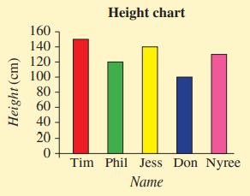
How tall is Jess?
Who is the tallest?
What is the height of the shortest person?
How much taller is Tim than Jess?

Slide 13
Misleading data
https://www.youtube.com/watch?v=E91bGT9BjYk
Think: what does the video tell you to look out for?

Slide 14
What must a graph have?
T_____
L______
S______
itle
abelled axis
cale

Slide 15
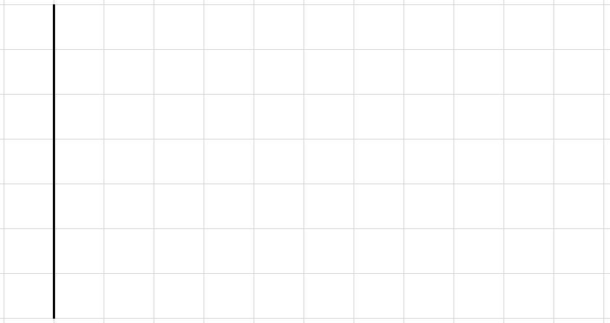
Misleading representations
10
9
What is wrong with this graph?
What is it missing?
6
4
2

Slide 16
Individual practice
HAESE 7
Page 320
Questions 4 - 13

